Slide 1
Geotechnical analysis
METHOD
THEORETICAL REQUIREMENTS
OF
Equilibrium
Compatibility
Constitutive
Boundary Conditions
ANALYSIS
Behaviour
Force
Disp.
Closed Form
Linear
Elastic
Rigid with
Limit Equilibrium
a failure
criterion
Rigid with
Stress Field
a failure
criterion
Limit
L.B.
Ideal
Analysis
U.B.
Plasticity
Any
Full Numerical

Slide 2
Stress Field Method of Analysis
Lecture objectives:
to define assumptions involved with this method of analysis
to apply stress fields in the analysis of geotechnical structures

Slide 3
Stress Field
Assumptions of the method
The soil is assumed to be at failure everywhere within the
continuum
Solution is obtained by combining the failure criterion with
the equilibrium equations
H=?
∂σ_{v}
∂σ_{h}
or
element
of soil
continuum

Slide 4
Stress Field
Stress field equations
For the plane strain conditions and the Mohr-Coulomb failure criterion:
Equilibrium equations:
σ_{y}
y
τ_{xy}
(1)
τ_{xy}
σ_{x}
γ
(2)
x
element of soil

Slide 5
Stress Field
Stress field equations
For the plane strain conditions and the Mohr-Coulomb failure criterion:
Mohr-Coulomb failure criterion:
Has to be expressed in terms of
component stresses σ_{x}, σ_{y}, τ_{xy}
σ_{y}
φ′
τ_{xy}
τ
τ_{xy}
σ_{x}′,τ_{xy}
c′
t
σ_{x}
τ_{f}
2θ
γ
σ₃′
σ_{n}
σ₁′
σ′
c′
σ_{y}′,τ_{xy}
φ′
s
t

Slide 6
Stress Field
Stress field equations
For the plane strain conditions and the Mohr-Coulomb failure criterion:
Mohr-Coulomb failure criterion:
φ′
τ
σ_{x}′,τ_{xy}
c′
t
2θ
σ₃′
σ₁′
σ′
c′
σ_{y}′,τ_{xy}
φ′
s
t
New expression for the failure criterion:
(3)

Slide 7
Stress Field
Stress field equations
For the plane strain conditions and the Mohr-Coulomb failure criterion:
(1)
(2)
(3)
The two equilibrium equations and the failure criterion provide three
equations in three unknowns: σ_{x} , σ_{y} , τ_{xy}
Theoretically, it should therefore be possible to obtain solutions for
all three unknowns

Slide 8
Stress Field
Stress field equations
For the plane strain conditions and the Mohr-Coulomb failure criterion
However, combining these three equations we obtain:
x-direction
y-direction
two hyperbolic partial differential equations
It is not possible to solve the above two equations in a closed form.
Solution is obtained by considering the characteristic directions of the
stress field and calculating stress variations along these directions.

Slide 9
Stress Field
Stress field equations
For the plane strain conditions and the Mohr-Coulomb failure criterion
Directions of stress characteristics are calculated from following
differential equations:
Along the above characteristics, stress changes are calculated as:
This is a set of 4 equations in 4 unknowns: x, y, s and θ, and, in principle
can be solved mathematically.

Slide 10
Stress Field
Stress field equations
For the plane strain conditions and the Mohr-Coulomb failure criterion
However, to date it has only been possible to obtain analytical solutions
for very simple problems and/or if the soil is assumed to be weightless
(i.e. γ=0)
Solutions based on these equations only provide a partial stress field
which covers only the zone of interest, but not the whole continuum

Slide 11
Stress Field
Stress field application
For the plane strain conditions and the Mohr-Coulomb failure criterion
Examples
dy
Retaining
wall
dx
y
x

Slide 12
Stress Field
Stress field application
For the plane strain conditions and the Mohr-Coulomb failure criterion
Examples
Retaining
wall
y
x
Partial stress field

Slide 13
Stress Field
Stress field application
For the plane strain conditions and the Mohr-Coulomb failure criterion
Examples
σ
y
a
y
σ
2R
T
x
σ_{T} – tunnel support pressure
What magnitude of the surface pressure will cause tunnel collapse
for a given magnitude of σ_{T}

Slide 14
Stress Field
Stress field application
For the plane strain conditions and the Mohr-Coulomb failure criterion
Examples
Cross-section
at a=R
Cross-section
at a=R/2
Tunnel
R
Typical mesh of
characteristic directions

Slide 15
Stress Field
Stress field application
For the plane strain conditions and the Mohr-Coulomb failure criterion
Examples
30
σ_{T} = 1 kPa
σ_{y}/(γR)
20
φ′ = 45º
a/R = 1/2
10
0
0
1
2
3
4
5
6
7
8
x/R
σ
x
y
a
σ
2R
T

Slide 16
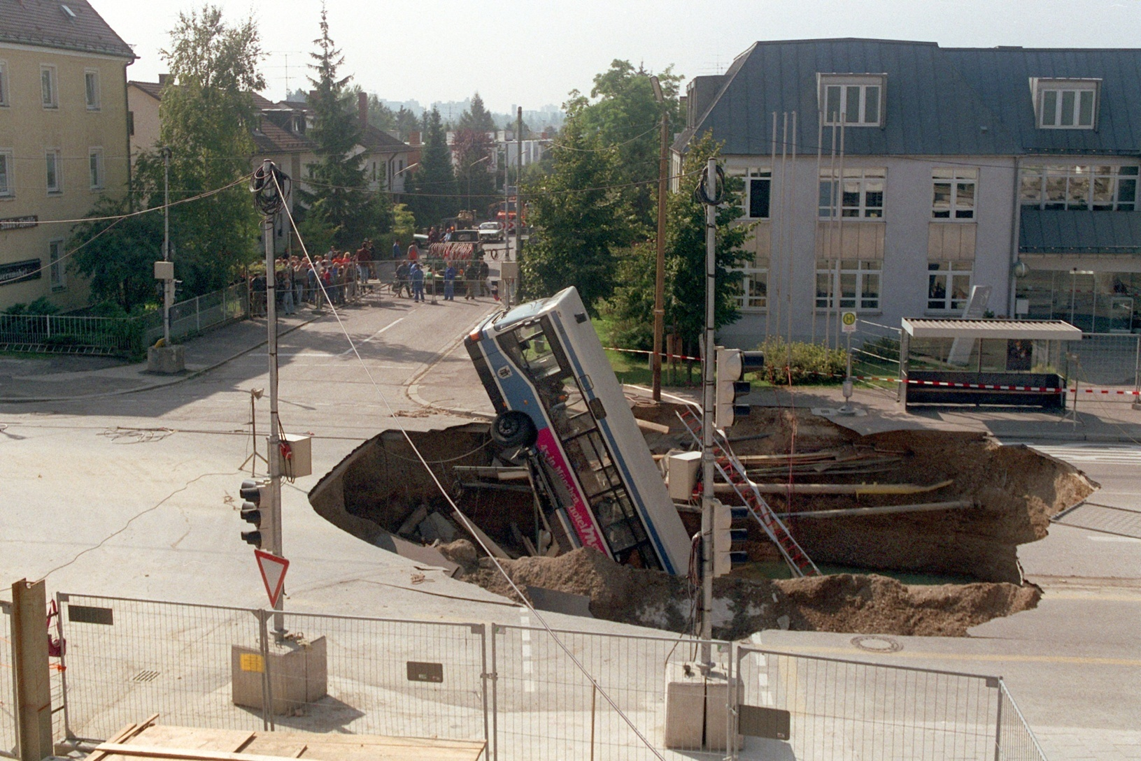
Stress Field
Collapse of tunnel face / Munich 1994
In reality, failure is localised

Slide 17
Stress Field
Rankine states of stress
Consider a semi-infinite cohesionless soil mass in a K_{o} state of stress
x
y
1
y
σ_{y}′
σ_{x}′=K_{o}σ_{y}′
Consider that we apply lateral extension to this soil mass
As a consequence: σ_{x}′ decreases
σ_{y}′ remains unchanged
This continues until failure is reached and σ_{x}′ cannot reduce any more,
resulting in active stress state in the ground

Slide 18
Stress Field
Rankine states of stress
Consider a semi-infinite cohesionless soil mass in a K_{o} state of stress
x
y
1
y
σ_{y}′
σ_{x}′=K_{o}σ_{y}′
This continues until failure is reached and σ_{x}′ cannot reduce any more,
resulting in active stress state in the ground
active earth
pressure
coefficient

Slide 19
Stress Field
Rankine states of stress
Consider a semi-infinite cohesionless soil mass in a K_{o} state of stress
x
y
1
y
σ_{y}′
σ_{x}′=K_{o}σ_{y}′
Consider that we apply lateral compression to this soil mass
As a consequence: σ_{x}′ increases
σ_{y}′ remains unchanged
This continues until failure is reached and σ_{x}′ cannot increase any more,
resulting in passive stress state in the ground

Slide 20
Stress Field
Rankine states of stress
Consider a semi-infinite cohesionless soil mass in a K_{o} state of stress
x
y
1
y
σ_{y}′
σ_{x}′=K_{o}σ_{y}′
This continues until failure is reached and σ_{x}′ cannot increase any more,
resulting in passive stress state in the ground
passive earth
pressure
coefficient

Slide 21
Stress Field
Rankine states of stress
Consider a semi-infinite cohesionless soil mass in a K_{o} state of stress
x
y
1
y
σ_{y}′
σ_{x}′=K_{o}σ_{y}′
Because of uniform lateral extension/compression of the whole soil mass,
a uniform stress field exists in active/passive stress state.
In both cases shear stress τ_{xy} = 0.
Consequently, σ_{x}′ and σ_{y}′ are principal stresses.

Slide 22
Stress Field
Rankine states of stress – active case
φ′
plane of
maximum
stress
obliquity
τ
active
circle
K_{o} circle
a
c′
P
α
σ_{y}′
σ_{x}′
α
A
σ′
c′
σ_{xa}′
a′
c′.cotφ′
σ_{y}′
φ′
σ_{y}′ remains constant
σ_{x}′ reduces

Slide 23
Stress Field
Rankine states of stress – active case
φ′
plane of
maximum
stress
obliquity
τ
active
circle
a
c′
P
α
σ_{y}′
α
A
σ′
c′
σ_{xa}′
a′
c′.cotφ′
σ_{y}′
φ′
From the Mohr circle geometry:
Combining these two
equations we obtain

Slide 24
Stress Field
Rankine states of stress – active case
φ′
plane of
maximum
stress
obliquity
τ
active
circle
a
c′
P
α
σ_{y}′
α
A
σ′
c′
σ_{xa}′
a′
c′.cotφ′
σ_{y}′
φ′

Slide 25
Stress Field
Rankine states of stress – passive case
passive
circle
φ′
τ
K_{o} circle
plane of
maximum
stress
obliquity
b
c′
σ_{y}′
σ_{x}′
β
P
B
β
σ′
c′
σ_{xp}′
c′.cotφ′
σ_{y}′
b′
φ′
σ_{y}′ remains constant
σ_{x}′ increases

Slide 26
Stress Field
Rankine states of stress – passive case
passive
circle
φ′
τ
plane of
maximum
stress
obliquity
b
c′
σ_{y}′
β
P
B
β
σ′
c′
σ_{xp}′
c′.cotφ′
σ_{y}′
b′
φ′
From the Mohr circle geometry:
Combining these two
equations we obtain

Slide 27
Stress Field
Rankine states of stress – passive case
passive
circle
φ′
τ
plane of
maximum
stress
obliquity
b
c′
σ_{y}′
β
P
B
β
σ′
c′
σ_{xp}′
c′.cotφ′
σ_{y}′
b′
φ′

Slide 28
Stress Field
Rankine states of stress – active + passive
passive
circle
φ′
plane of
maximum
stress
obliquity
τ
active
circle
plane of
maximum
stress
obliquity
b
a
c′
σ_{y}′
P
α
σ_{y}′
β
P
α
A
B
β
σ′
c′
σ_{xa}′
a′
σ_{xp}′
c′.cotφ′
σ_{y}′
b′
φ′

Slide 29
Stress Field
Rankine states of stress
Planes of maximum stress obliquity are characteristic directions
Active case
σ₁′ = σ_{y}′

Slide 30
Stress Field
Rankine states of stress
Planes of maximum stress obliquity are characteristic directions
Passive case
σ₁′ = σ_{x}′

Slide 31
Stress Field
Summary
In terms of how it satisfies 4 main theoretical requirements, the Stress Field
method is very similar to the Limit Equilibrium method of analysis
The main difference between the two is in the assumption of failure
It is not easy to solve partial differential equations of the Stress Field method;
they require numerical integration and further assumptions
The most applicable solutions of the Stress Field method are Rankine
active and passive earth pressure coefficients
This method is also applied in solving bearing capacity problems of
foundations

